Slide 1


WAITX: An Arbiter for Non-Persistent Signals
Victor Khomenko, Danil Sokolov,
Andrey Mokhov, Alex Yakovlev

Slide 2







Motivation
‘Dirty’ analogue part of the system
A2D interfaces
‘Clean’ digital core of the system
Non-persistent signals, e.g. comparator outputs
short pulses
bursts of high-frequency jitter
Not-quite-digital waveforms
Sanitize ‘dirty’ signals coming from the analogue part before passing them to the digital core
Special interface elements are needed – ASYNC
All signals must be well-behaved
Nice digital waveforms
Any bad behaviour may lead to malfunction
Formally verified ☺
Notes:
1

Slide 3
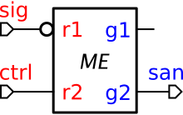
WAIT [ASYNC’15, Kessels & Marston’99]
Upon activation by ctrl+, waits for sig=1 (may miss short spikes) and latches it as ‘clean’ san
‘Clean’ ctrl / san handshake controlled by ‘dirty’ sig

Slide 4
Debubblification of WAIT
The input bubble on sig can be detached:
The inverter can produce hazards, but they will not propagate past the mutex!
Dropping the bubble altogether yields WAIT0 that waits for sig=0 rather than sig=1
Idiom

Slide 5

WAITX element: the protocol
Upon activation by ctrl+, arbitrates between ‘dirty’ sig1 and sig2
Grants g1 and g2 are clean and mutually exclusive
Clean ctrl / (g1 or g2) handshake controlled by ‘dirty’ sig1 and sig2

Slide 6
Application: multiphase buck (DATE’17)

Slide 7
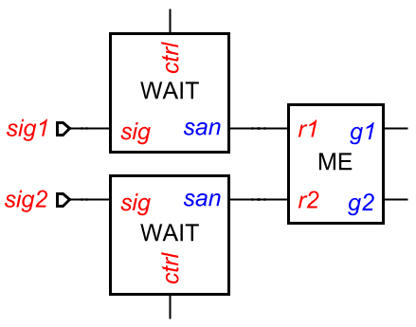

WAITX element: top-level structure
Idea: sanitise sig1 and sig2 with WAITs, and then arbitrate with a usual mutex
Problem: Cannot reset the losing WAIT:
  its sig may never arrive
  cannot withdraw its ctrl – hazard if sig does arrive
Idiom

Slide 8
WAITX element: top-level structure
Idiom
Idea: The winner helps the loser!
The mutex’s winning grant ‘helps’ the losing signal to arrive (via NOR gates), so that both WAIT0 elements fire at each cycle and can be safely reset
The outputs of the NOR gates are ‘dirty’, but the hazards do not propagate past WAIT0s

Slide 9
STG for CONTROL
Reset phase is long (5 gate delays between g1+ and g1-), but concurrent to the environment’s consuming the grant
Losing signal does not propagate through the mutex, i.e. an extension of the usual arbitration protocol is used
Losing WAIT0 must be reset before the winning one

Slide 10
CONTROL implementation

Slide 11
SAMPLE element
Upon activation by ctrl+, sample the current value of ‘dirty’ sig and return it to the caller as a ‘clean’ dual-rail value d0 / d1; no waiting, i.e. non-blocking
Clean ctrl / (d0 or d1) handshake controlled by ‘dirty’ sig

Slide 12
Summary
New reusable WAITX element to arbitrate between ‘dirty’ signals (e.g. A2D or cross-domain interfaces)
Unconditionally guarantees that bad behaviour of the inputs will not propagate to the digital ‘core’
Speed-independent implementation of WAITX that uses only digital components – no transistor meshes, Schmitt triggers, etc.; the only non-digital dependency is the (well studied) metastability filter inside mutex / WAIT
Formally verified
Can be scaled to multiple inputs
WAITX can be used to implement an unconditionally safe SAMPLE

Slide 13
SI circuits: progress / extensions
Intuition: circuits that work “correctly” regardless of gate delays
Interfacing with rough world (cross-domain, analogue, …) by sanitising non-persistent input signals
WAIT, WAITX, SAMPLE…
input/output read/consume choices
“Factoring out” mutexes into the environment
output/output choices & internal arbitration
Maintaining semi-modularity w.r.t. a state:
input/input choices
Muller’s theory:
“closed” systems, inertial delays
no choices
this work

Slide 14
Thank you!
Any questions?

