Slide 1
Dual-Rail Control Logic for
Enhanced Circuit Robustness
Andrey Mokhov, Victor Khomenko
Danil Sokolov, Alex Yakovlev

Slide 2
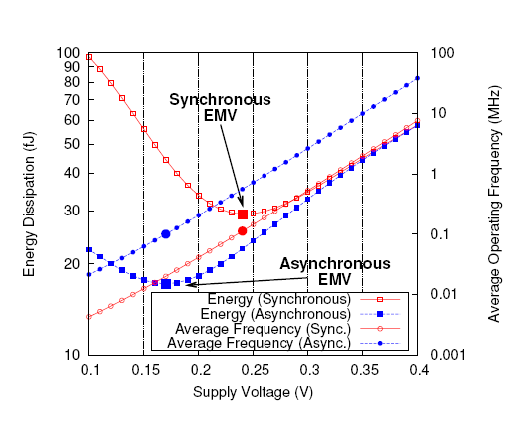
Motivation
Source:
Akgun et al, ASYNC’10
  Optimal operating voltage lies near or below sub-threshold voltage
  Low voltage leads to unpredictable delay variations
    Asynchronous circuits can be pushed to work at lower voltages
    Single-rail asynchronous circuits are not robust enough – why?

Slide 3
Why not single-rail circuits?
Advantages of single-rail:
  Just one wire per signal: simple, natural, widely adopted
  Efficient in terms of area, latency, and power consumption
  Extensive tool support (Petrify, Punf/Mpsat, Workcraft)
Disadvantages of single-rail for low voltage operation:
  Often not speed-independent due to input inverters
  Vulnerable to single-event upsets (SEU)
  Require significant effort to balance wire forks
Dual-rail circuits:
  Two wires per signal: more complex, poor tool support
  No input inverters, more robust to SEU, fewer wire forks
  Small overhead in terms of area, latency, power

Slide 4
Example: pipeline controller
STG specification
CSC conflicts resolved

Slide 5
Example: single-rail implementation
Synthesised automatically (by Petrify or Punf/Mpsat)
Needs big atomic gates
Contains 5 input inverters

Slide 6
Example: single-rail implementation
Hazard on
output Ao.
Race between csc0+ and i1-.
Not speed-independent! Problematic trace:
Ri+; Ro+; Ao+; i2-; i3-; csc0-; i4+; Ai+; i5-; csc1-; i1+; Ro-; i2+; Ri-; Ao-; i3+; Ai-; i5+; csc1+

Slide 7
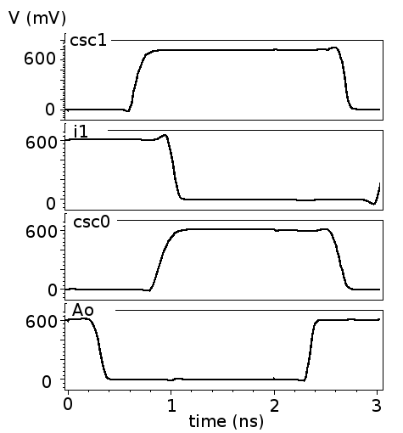
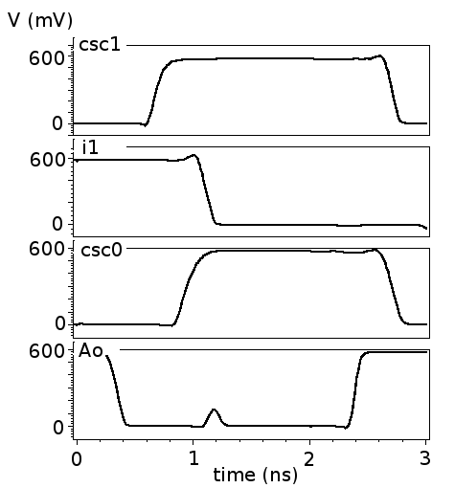
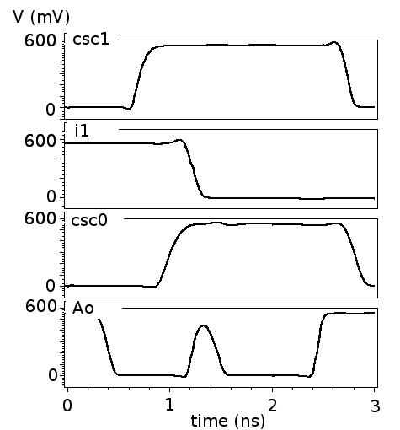
Example: simulation
No hazard
Hazard (below threshold)
Hazard
V_{dd} = 600-1000mV
V_{dd} = 575mV
V_{dd} = 550mV
Low voltages cause many ‘realistic’ timing assumptions to fail

Slide 8
Input inverters
Assumed to be faster than any adversary path passing through other logic gates
  Realistic assumption under normal operating voltage
  Can lead to hazards due to high delay variations in low voltage mode and/or new fabrication technology
Can be difficult to eliminate
Dual-rail encoding is the key!

Slide 9
Dual-rail encoding
Uses two physical wires to represent one logical signal:
No need for inverters: inversion is done by swapping rails:
=

Slide 10
Transition protocol
DR datapath
spacer propagation
(for comparison):

Slide 11
Overview of implementation styles
Single-rail implementations:
Complex gate (CG)
Generalised-C (gC)
Standard-C (stdC)
Dual-rail implementations:
Generalised-RS (gRS)
Standard-RS (stdRS)

Slide 12
Basic dual-rail elements: repeater
gates
transistors
Repeater insertion to
minimise wire delays:

Slide 13
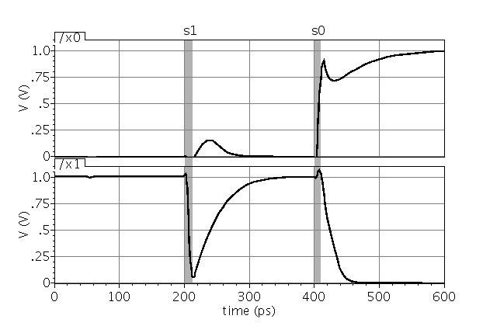
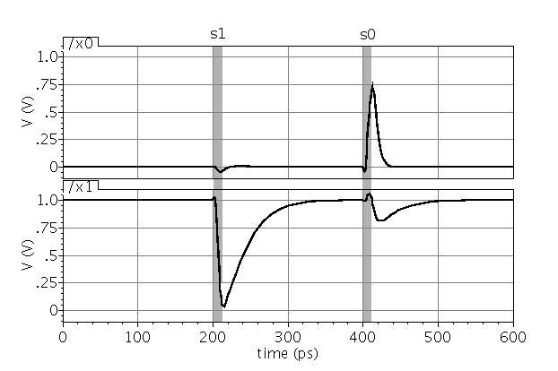
Recovery from Single Event Upsets
SEU in spacer state:
- repeater recovers from s1
- repeater cannot recover from s0
SEU in codeword state:
- repeater recovers from s1
- repeater recovers from s0

Slide 14
Basic dual-rail elements: C-element
dual-rail
Transistor-level implementations

Slide 15
Example: dual-rail implementation
No input inverters → speed-independent!

Slide 16
Example: comparison
Single rail
Dual rail

Slide 17
Experiments: area (literals)
Average results:
CG 100%
stdC 189%
stdRS 151%
gRS 115%

Slide 18
Experiments: power (wire load)
Average results:
CG 100%
stdC 181%
stdRS 130%
gRS 99%

Slide 19
Experiments: fork balancing effort
Dual rail circuits require twice less balancing effort!

Slide 20
Conclusions and future work
We demonstrated that dual rail control circuits:
  Have no input inverters → speed-independent
  Have fewer forks (less average wire load)
  Can recover from most SEUs
  Small overhead in terms of area, power, latency
  Can be synthesised with existing tools
Future work:
  SEU-aware synthesis (reduce spacer period)
  RS-latch testability
  Exploring multi-valued control logic (> 2 rails)

Slide 21
Thank you!

