Slide 1
Design and Verification of Speed-Independent Circuits with Arbitration in Workcraft
Victor Khomenko¹, Danil Sokolov¹, Alex Yakovlev¹, David Lloyd²
¹Newcastle University, UK ²Dialog Semiconductor, UK

Slide 2
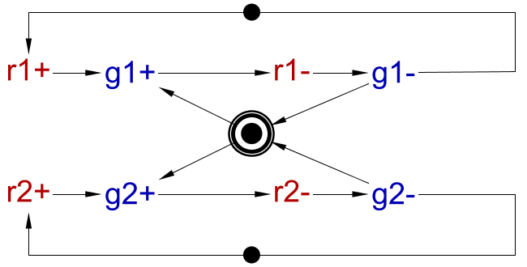
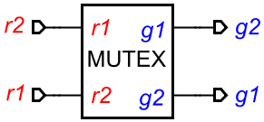
Arbitration
Choice between output (or internal) signals – leads to violation of output-persistence
Can be implemented with a mutex if the mutex protocol is followed (could be early-release or late-release)

Slide 3
Traditional synthesis flow
Manually factor out arbitration to the environment
Synthesise the remaining controller (mutex grants are now inputs)
Manually add mutexes to the synthesised controller
Significant manual effort
No guarantee the mutex protocol is actually followed
False violations of output-persistence due to choices between grants
May miss non-persistence due to premature withdrawal of grants
Verification of a circuit with mutexes is non-trivial

Slide 4
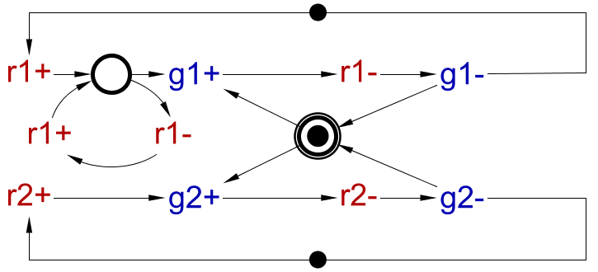
Traditional synthesis flow – example
When the arbitration is factored out, g1 and g2 become inputs, so verification will not catch the glitch on g1 due to premature withdrawal of r1

Slide 5
The new flow: (1) STG verification
The user tags some choice places as mutex places
The tool automatically determines the requests/grants
The mutex protocol is formally verified
The output-persistence check is re-formulated:
choices between mutex grants are not violations
violations due to a premature withdrawal of a request are caught

Slide 6
Mutex protocol check
Constraints on the grants’ next-state functions:
The protocol’s flexibility is captured, e.g. if $r1∙\overline{r2}∙g2$ then $g1′$ is unconstrained
Extra constraint for the initial state: $\overline{(r1∙g1)∙(r2∙g2)}$
$$\begin{matrix}r1∙\overline{g2}⟹g1′ \\ \overline{r1}⟹\overline{g1^{′}} \\ r2∙g2⟹\overline{g1′}\end{matrix}$$ | $$\begin{matrix}r2∙\overline{g1}⟹g2′ \\ \overline{r2}⟹\overline{g2^{′}} \\ r1∙g1⟹\overline{g2′}\end{matrix}$$

Slide 7
The new flow: (2) synthesis
The arbitration is automatically factored out to the environment
The remaining part of the controller is synthesised
Mutexes are automatically added to the resulting controller

Slide 8
The new flow: (3) circuit verification
The usual verification by composing the circuit with the environment may report false deadlocks and other problems due to inconsistent selection of choice branches
Thus mutex grants must be exposed as outputs before the composition – done automatically by the tool

Slide 9
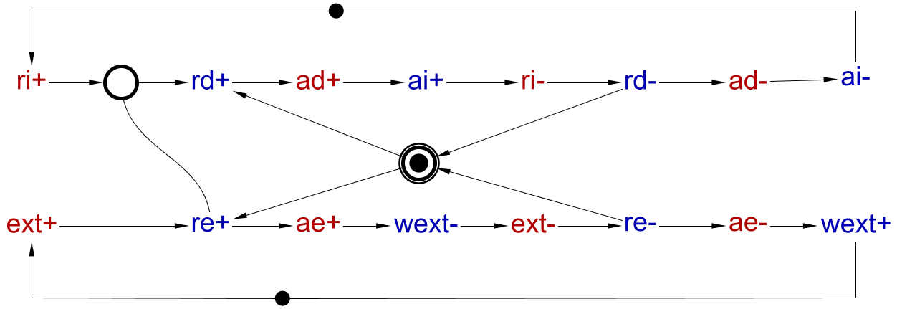
Example: two-mode delay element
Ordinary place
Requests
Mutex place
Grants
Verification of the mutex protocol fails – intuitively, ri+ can trigger both rd+ and re+

Slide 10
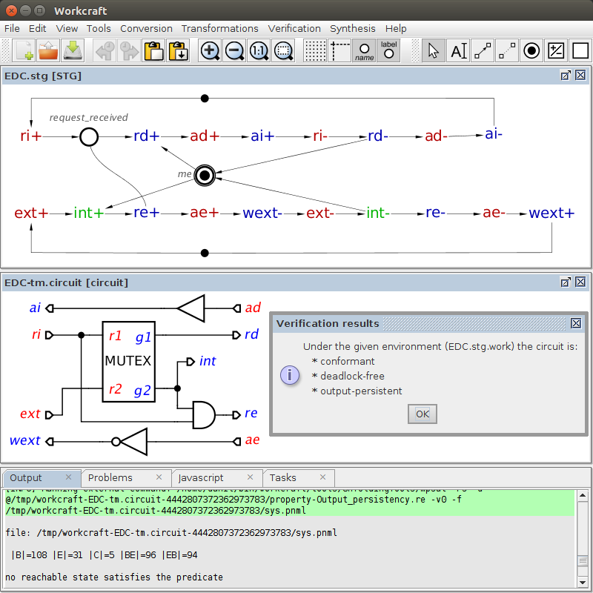
Example (continued)

