Slide 1

Formal Design and Verification of an Asynchronous SRAM Controller
Victor Khomenko, Andrey Mokhov, Danil Sokolov, Alex Yakovlev

Slide 2
Motivation
SRAM is a ubiquitous component
so must be robust and efficient
Advantages of asynchronous SRAM:
reliable operation under a wide range of supply voltages
can trade off energy for performance (essential for low-power devices, e.g. powered by energy harvesters)
Fascinating challenge for the application of formal models of concurrency!

Slide 3
Conventional 6T SRAM
Reading: precharge bit-lines, assert WL, sense bit-line changes
Writing: set data lines, assert WL and WE, wait for a while…

Slide 4
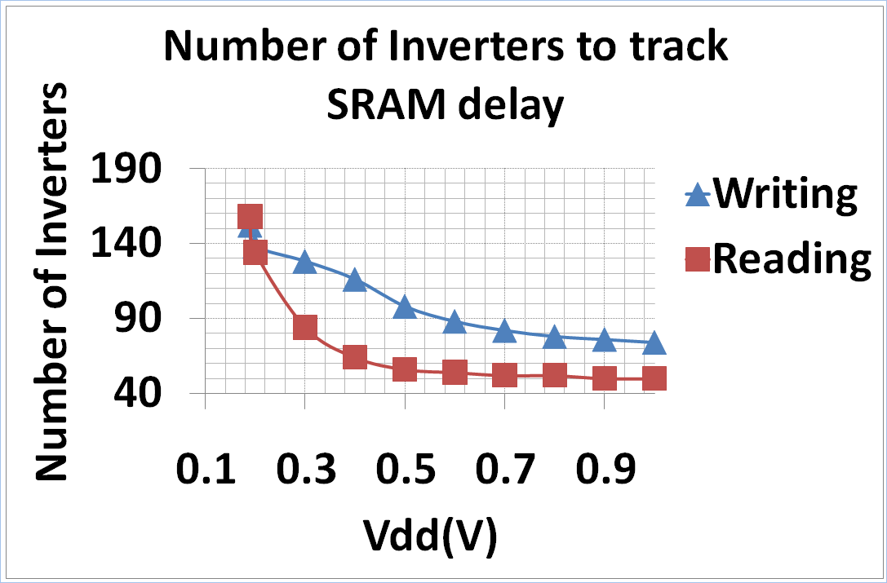
Problem: how long to wait?

Slide 5
Previous work
Using non-standard memory cells
Extra transistors, and
Extra bit-lines or acknowledgement lines
Different delay lines for different voltages
Voltage references
Duplicating an SRAM line to act as a reference delay line

Slide 6
Previous work (cont’d)
Async solution with completion detection
developed by A. Baz et al. (PATMOS 2010, JOLPE 2011) based on the original idea of V. Varshavsky (USSR Patent, 1988)
no voltage references
speed-independent, but
interface to bit-lines is not delay-insensitive
less robust in the low-power mode, especially if bit-lines are buffered or augmented with a sense amplifier
Completion detection in write mode idea:
easy when the bit is flipped
read before writing to check if the bit needs flipping

Slide 7
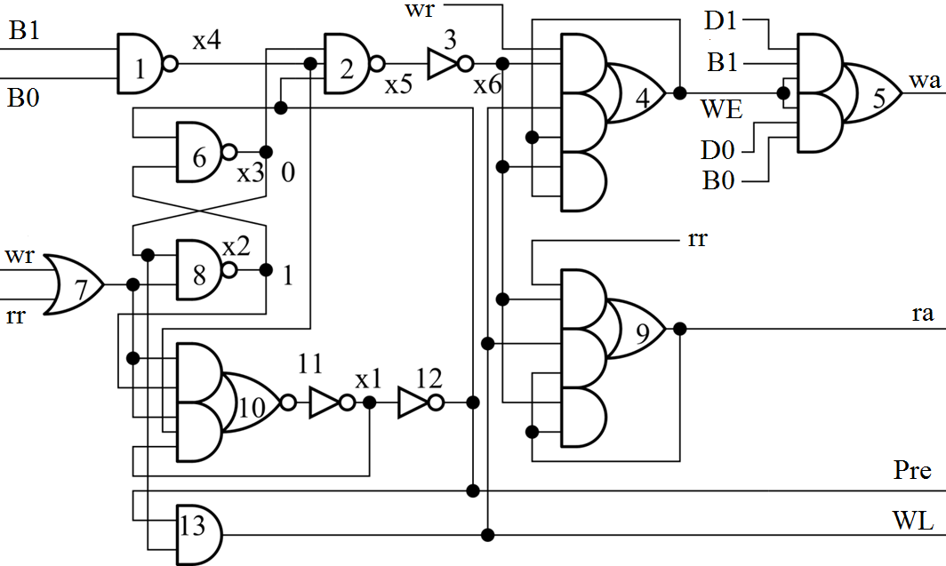
Previous work (cont’d)
Hazard due to transient (1,1) on the bit-lines

Slide 8
Delay models
Delay-insensitive (DI) circuits:
Both gate delays and wire delays are positive and finite, but variable and unbounded
Very robust, but there are very few DI circuits
Speed-independent (SI) circuits:
Gate delays are positive and finite, but variable and unbounded
Wire delays are negligible (alternatively, wire forks are isochronic)
OK for small blocks, but inter-block communication may be problematic due to long and/or buffered wires
Compromise:
SI blocks with DI interfaces

Slide 9
Specification: top-level structure

Slide 10
Specification: Master

Slide 11
Specification: SlaveRead

Slide 12
Specification: ReadCompletion

Slide 13
Specification: WriteCompletion

Slide 14
Simulation results
Only a rough idea
Read cycle (both set and reset phases) is ~3% slower compared to [Baz et al.]
In write mode the overhead is ~11% if the bit-lines flip and ~20% otherwise
Acceptable (?) cost for delay-insensitive interface to bit-lines

Slide 15

Summary
An alternative to [Baz et al.] design of an asynchronous SRAM controller
delay-insensitive interface to bit-lines
performance overhead is small
Systematically designed
Formally verified
The design flow is supported by:
workcraft.org

Slide 16
Future work
We have ideas how to optimise our design
Fine-tuning the circuit at the transistor and layout levels to push the minimum operating voltage further down
Produce it on silicon to confirm the possibility of reliable operation at sub-threshold voltages

Slide 17
Thank you! Any questions?

