Slide 1


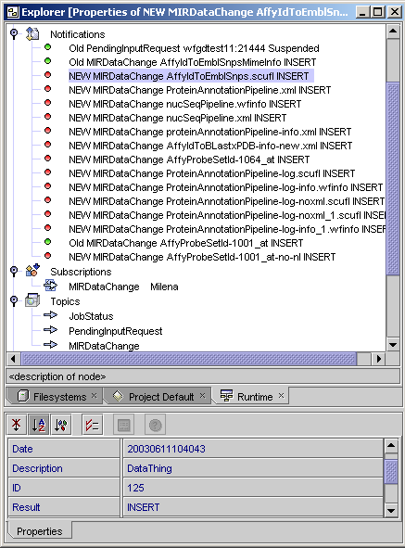
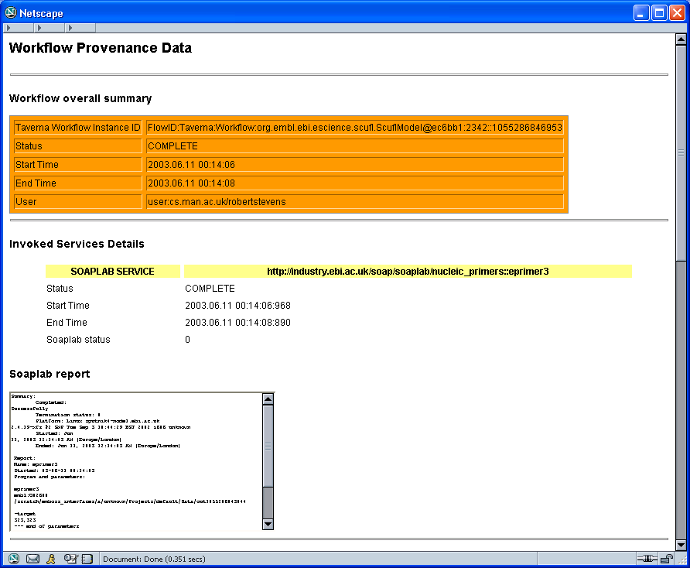
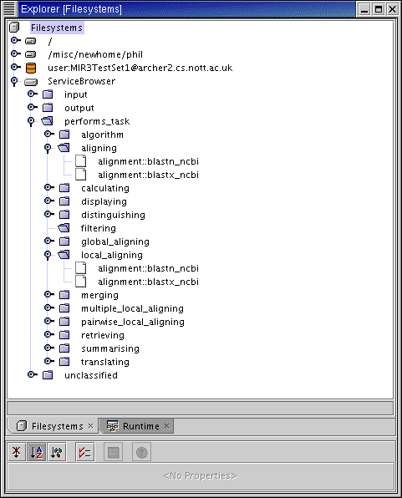
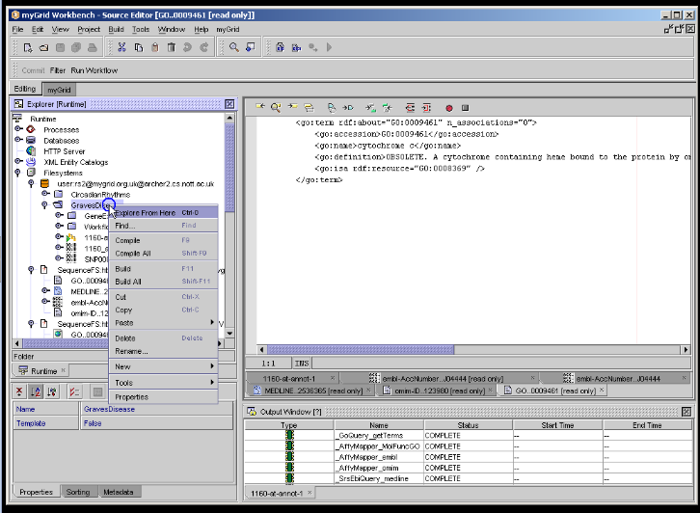
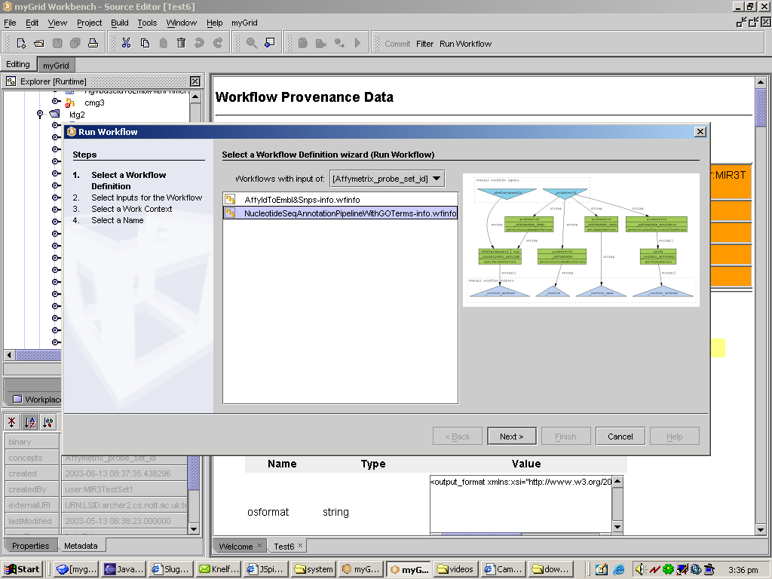
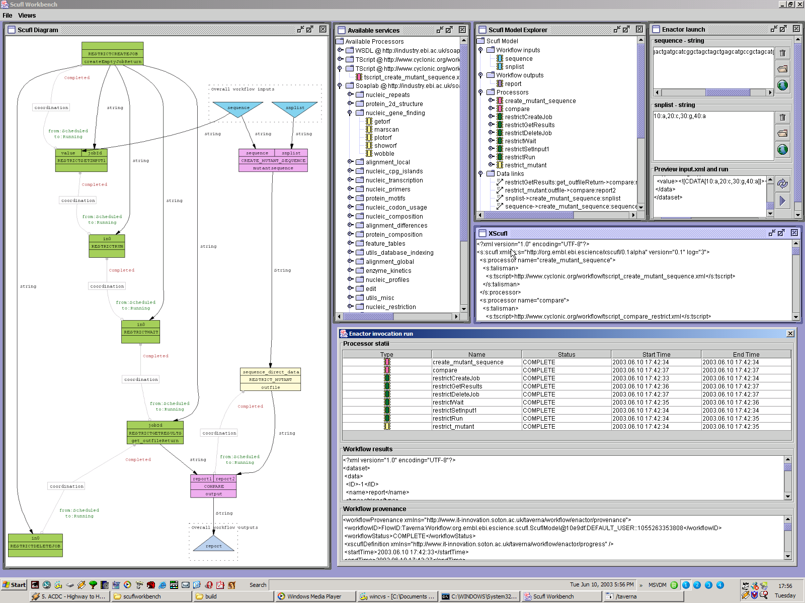







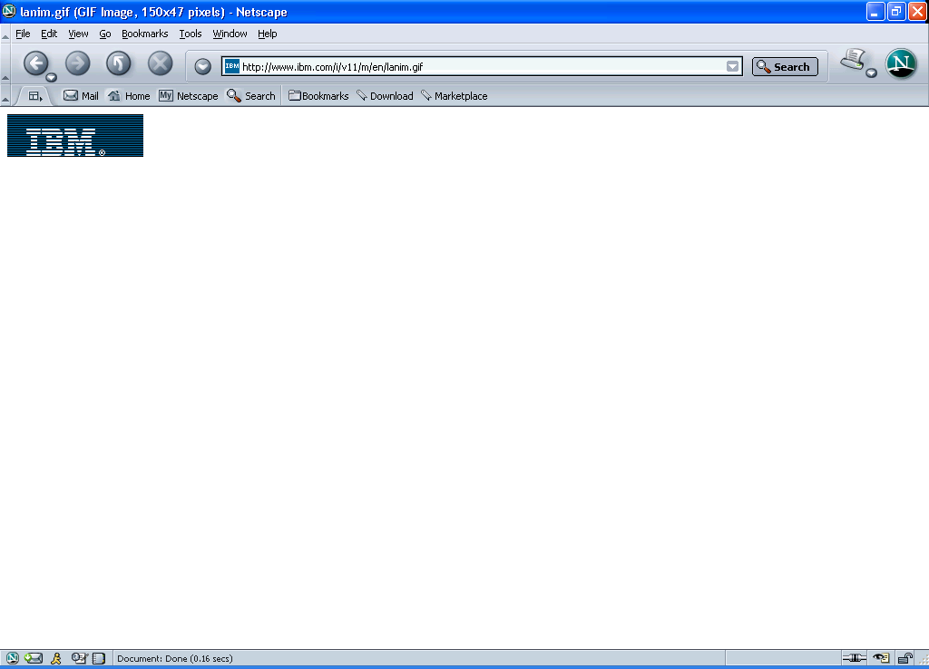





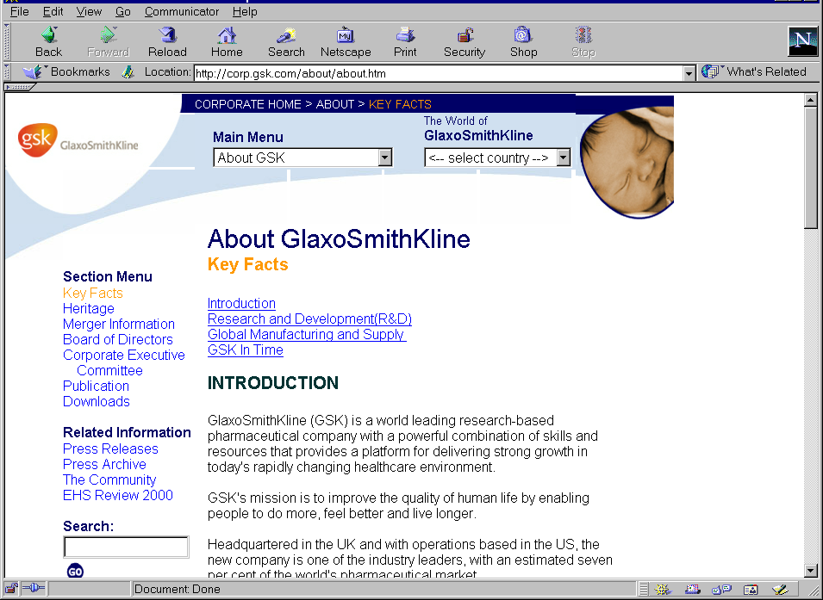

Performing in silico experiments on the Grid using ^{my}Grid. Robert Stevens, Phillip Lord, Tom Oinn and Peter Li. http://www.mygrid.org.uk
Pituitary
Gland
TSH
We have selected a microarray experiment based on Graves Disease (GD) as a scenario for the demonstrator application. GD is caused by an auto-immune response against the thyroid, causing hyperthyroidism. In this experiment we aim to identify genes with differential expression in GD patients.
TSH Receptor
The ^{my}Grid project aims to provide middleware layers that make the Information Grid appropriate for the needs of bioinformatics. ^{my}Grid is building high level services for data & application integration such as resource discovery
and workflow enactment. Additional services are provided to support the scientific method & best practice found at the bench but often neglected at the workstation, notably provenance management, change notification & personalisation. Semantically rich metadata expressed using ontologies is used to discover services and workflows. ^{my}Grid provides these services as middleware components, that can be used to build bioinformatics applications. An in silico laboratory workbench demonstrator is currently being developed with these components.
Thyroid
Cell
-ve feedback
effect
External Services
^{my}Grid Services
^{my}Grid Client
Thyroid Hormones Released
Notification
Notification
Client
^{M}IR
Annotation Pipeline
Bio-databases
User Proxy
Workbench
What is known about my candidate gene?
A notification service can inform the MIR and the user that data, workflows, services, etc. have changed and thus prompt actions over data in the ^{M}IR. Notifications are presented to the user with a client in the workbench environment.
User Gateway
Medline
UDDI
Registry View
EMBL
GO
SOAP-LAB
Service
Browser
EMBOSS
Finding Service
Query
Domain
Services
Enactment Engine
Taverna
Workflow Environment
OMIM
BLAST
DQP
Like a bench experiment, ^{my}Grid records the materials and methods it has used for an in silico experiment in a provenance log. This is the where, what, when and how the experiment was run.
Services within ^{my}Grid are described using semantic web technologies, enabling selection by the types of inputs they use, outputs they produce, or the bioinformatics tasks they perform.
Acknowledgements:
This work is supported by the UK e-Science programme EPSRC GR/R67743, & DARPA DAML subcontract PY-1149, Stanford University.
The authors would like to acknowledge the myGrid team: Matthew Addis, Nedim Alpdemir, Rich Cawley, Vijay Dialani, Alvaro Fernandes, Justin Ferris, Rob Gaizauskas, Kevin Glover, Carole Goble (director), Chris Greenhalgh, Mark Greenwood, Ananth Krishna, Xiaojian Liu, Darren Marvin, Karon Mee, Simon Miles, Luc Moreau, Juri Papay, Norman Paton, Steve Pettifer, Milena Radenkovic, Peter Rice, Angus Roberts, Alan Robinson, Martin Senger, Nick Sharman, Paul Watson, Anil Wipat & Chris Wroe.
The Graves Disease case study is from Simon Pearce and Claire Jennings, Institute of Human Genetics,School of Clinical Medical Sciences, University of Newcastle.
The ^{my}Grid service components have been used in a demonstration application called the “^{my}Grid WorkBench”, which provides a common point of use for the services. We can select data from the ^{my}Grid Information repository (^{M}IR), select a workflow based on its semantic description, and examine the results.
Bioinformatics analyses typically involve visiting many data resources and analytical tools. These in silico experiments can be created as pipelines or “workflows” in the Taverna editor.

