Slide 1
Self-Enforcing E-Voting (SEEV)
Feng Hao
Newcastle University, UK
CryptoForma’13, Egham

Slide 2
What’s e-voting?
“An electronic voting (e-voting) system is a voting system in which the election data is recorded, stored and processed primarily as digital information.”
Network Voting System Standards
VoteHere inc, 2002

Slide 3
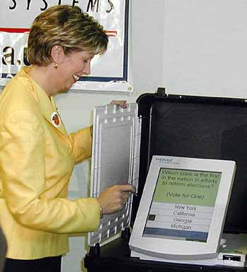
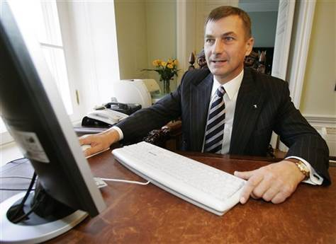
Real-world e-voting
DRE at local polling station
(e.g., widely used in USA, India, Brazil)
Remote e-voting
(e.g., Estonia Internet voting 2007)

Slide 4
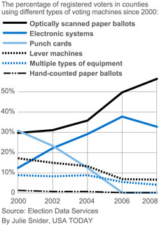
Controversies of e-voting
2000, rapid adoption of e-voting in the USA
2006, rapid abandonment by several stages in US
2008, Netherlands suspended e-voting
2009, Germany declared e-voting unconstitutional
2009, Ireland scraped e-voting machines

Slide 5

What’s the future of e-voting?
Will e-voting be more widely used?
Or should it be abandoned?

Slide 6
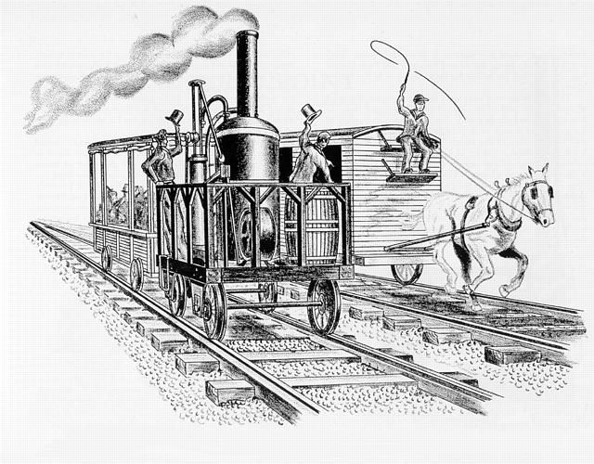
History of railway
There is always controversy with any new technology – we need to keep an open mind

Slide 7
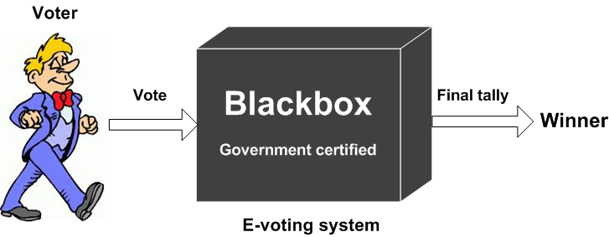
What’s wrong with existing e-voting?
A black-box voting system is not trustworthy
A hacker may alter the outcome without being noticed

Slide 8
E2E verifiable e-voting
End-to-end (E2E) verifiable
Individual: vote captured/recorded correctly
Universal: all votes tallied correctly
Not any new concept
Extensively researched for over 20 years
Many E2E schemes available
Problem solved?

Slide 9

Back to reality
What’s the impact of E2E schemes on real-world national elections?
Sadly, very little
What went wrong?

Slide 10
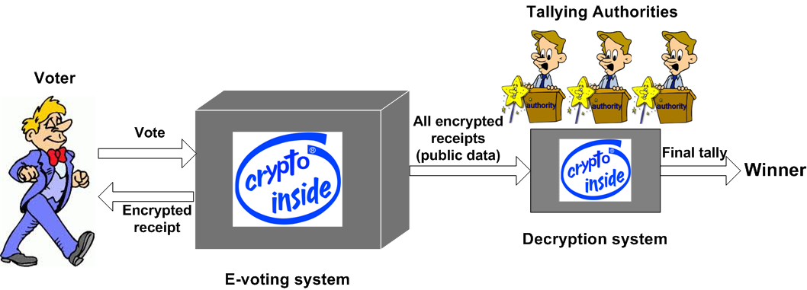
State-of-the-art E2E e-voting
However, basically the same as 20 years ago

Slide 11
What might be wrong?
All E2E e-voting systems involve tallying authorities (also known as trustees)
It is assumed that the tallying authorities
have distributed interest (hence do not collude)
understand cryptography
are computer experts
are extremely careful not to lose the key
How to implement such authorities?

Slide 12
A real-world example
Helios used to elect UCL university president in 2009
How were the authorities selected?
From university students/staff with different backgrounds
However, practical issues
The selected authorities didn’t know crypto
They didn’t have skills to write their own software
They didn’t know how to manage crypto keys
Practical solutions
Another group of “experts” did most of the work
Authorities were given the USB sticks with private keys
All keys were backed up by a trusted third party

Slide 13
Other practical problems of Helios
Requires to enable a browser plug-in
Requires to use a relatively fast client PC
Requires to execute downloaded code from Helios server
All these problems can be traced back to tallying authorities

Slide 14
Tallying authorities
The implementation of tallying authorities proves far more complex than many people have thought.
But what we challenge is the necessity:
Are they really needed?

Slide 15
Our goals
We want to design a system that works
We want to keep it simple
Keep the protocol simple
Keep the security proofs simple
Keep the implementation simple

Slide 16
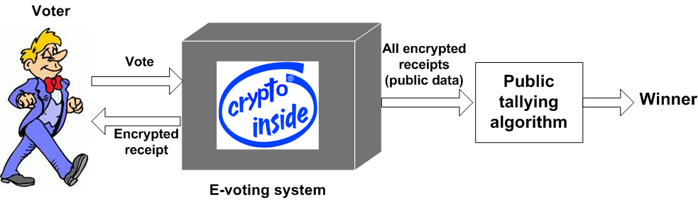
Our proposal: Self-Enforcing E-Voting
Basic intuition: cancelation of random factors in the public key encryption

Slide 17
Categories of e-voting protocols

Slide 18
How DRE-i works?
Three stages
Setup
Voting
Tallying

Slide 19
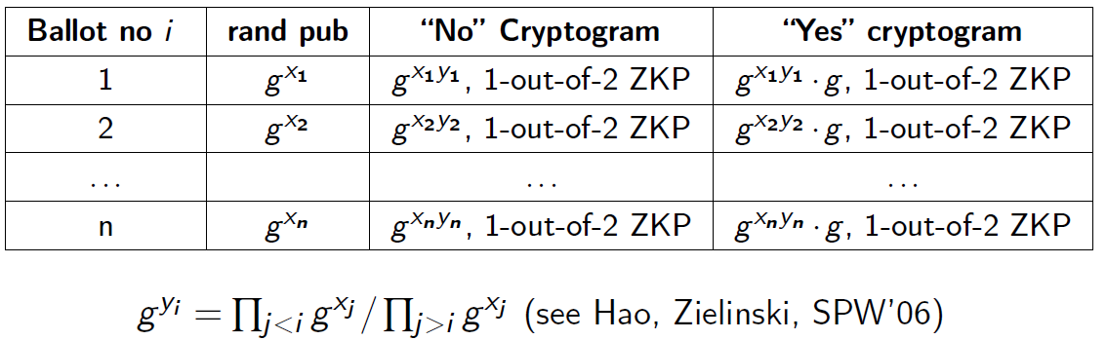
Stage 1: setup (single-candidate)
Well-formedness: all cryptograms are either “No” or “Yes”
Concealing: A single cryptogram doesn’t reveal “No” or “Yes”
Revealing: A pair of cryptograms reveal it is “No” or ”Yes”
Self-tallying: Any arbitrary selection of a cryptogram from each of the n ballots allows anyone to tally how many “Yes”

Slide 20
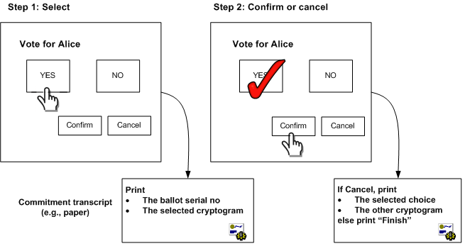
Stage 2: voting
Receipt is coercion-free: because of concealing
Voter initiated auditing: because of revealing

Slide 21
Stage 3: tallying
Usually the most complex part of an E2E e-voting system
But extremely simple in our case
Anyone can tally votes instantly after voting is finished
Because of the self-tallying property

Slide 22

Conclusion
Self-enforcing e-voting is a new type of E2E system that involves no tallying authorities
A feasible concept with good potential for real-world deployment.
Ongoing research supported by ERC (till 2018)
We welcome any interest for collaboration!

Slide 23
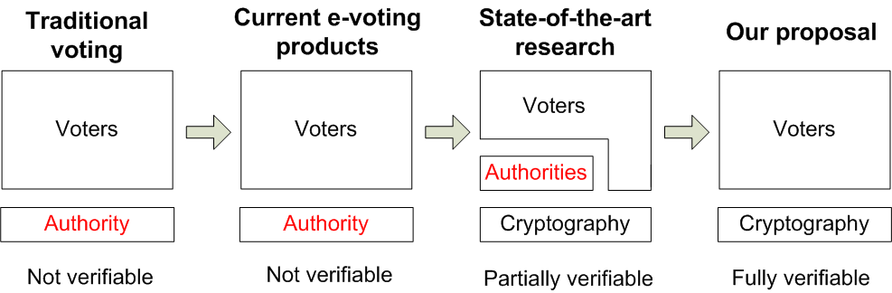
Future outlook

Slide 24
Thank you!

