Slide 1
On the Privacy of Private Browsing
Kiavash Satvat, Matt Forshaw, Feng Hao, Ehsan Toreini
Newcastle University
DPM’13

Slide 2
Introduction
2005, Safari first introduced private browsing
Today, private browsing has become an integrated feature in all major browsers
How many people use it in the real world?
19% based on a survey (Aggarwal et al, 2010)
2.4 billion Internet users (world stat, 2012)
Roughly, 450 millions users of private browsing
How secure is private browsing?

Slide 3
Threat model
First, need to define what is meant by “secure”
Local attacker
Capability: full physical access to the computer after private session, but not before
Goal: discover any sensitive information related to the private session
Remote attacker
Capability: able to engage with user through http (e.g., news website)
Goal: discover if the user is in the private session

Slide 4
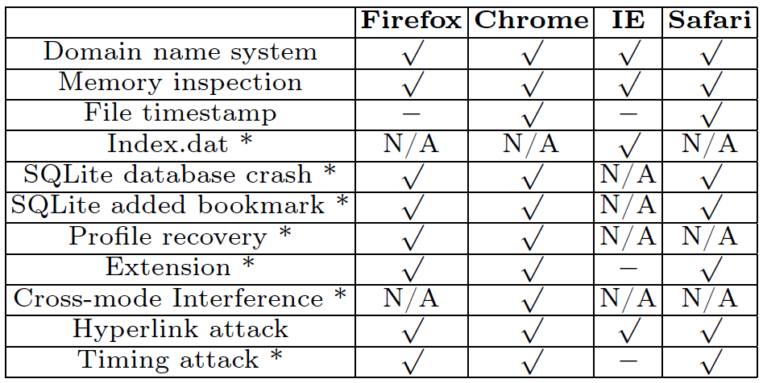
Summary of attacks
* new results discovered by our work
We will select only a few attacks to present here

Slide 5
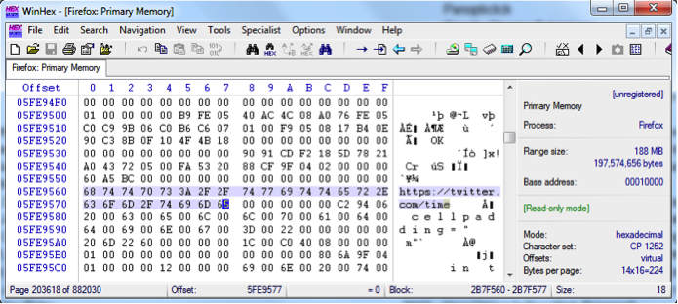
Local attack – memory inspection
Artefacts about private browsing scattered in memory even after the browser is closed

Slide 6
SQLite Database
SQLite: an open source database used by Firefox, Chrome and Safari to store user profile
In normal cases, it seems all browsers have removed private browsing records successfully
However, it is essential to also test edge cases:
When the browser crashes
When the user adds a bookmark

Slide 7
When the browser crashes
May happen due to overload, manual termination etc
Firefox (minor)
WAL files left on disk
Indicate occurrence of private browsing and times
Chrome (minor)
Journal files left on disk
Indicate occurrence of private browsing and time
Safari (serious)
Doesn’t use in-memory SQLite
Inserts records of private browsing and deletes later
But in case of crash, private browsing records will persist

Slide 8
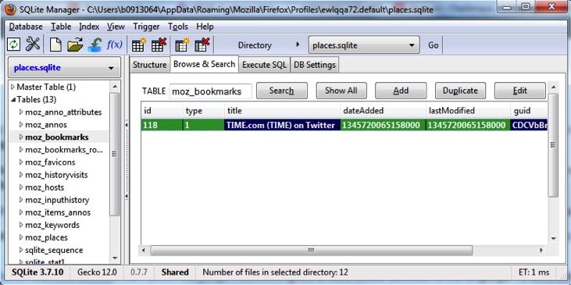
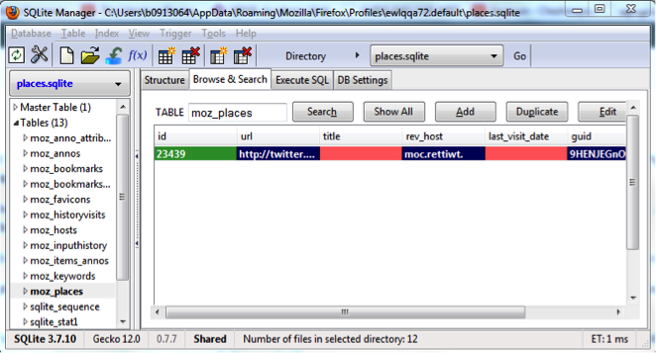
Adding a bookmark (Firefox)
Moz_bookmarks
(table)
Moz_places
(table)
Empty title and last_visit_date

Slide 9
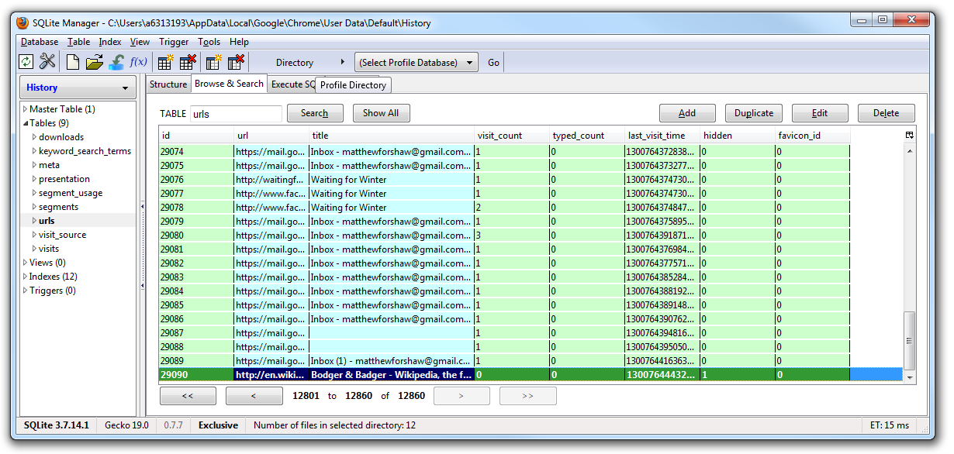
Adding a bookmark (Chrome)
Vist_count = 0
Hidden = 1

Slide 10
Adding a bookmark (Safari)
(serious) Once the user adds one bookmark, all websites visited in private mode will persist in the database.
We filed a bug report (#14685058)
12/08 (Apple): “Engineering has determined that this is not to be fixed.”
13/08, we asked Apple to clarify the decision.
18/08 (Apple): “After much deliberation, engineering has removed this feature.”

Slide 11
Browser extensions
Browser extensions pose a realistic threat to break privacy of private browsing.
We tested four latest browsers in 2013
Firefox: extension enabled by default (vulnerable)
Safari: extension enabled by default (vulnerable)
Chrome: extension disabled by default (good)
IE: extensions disabled by default (good)

Slide 12
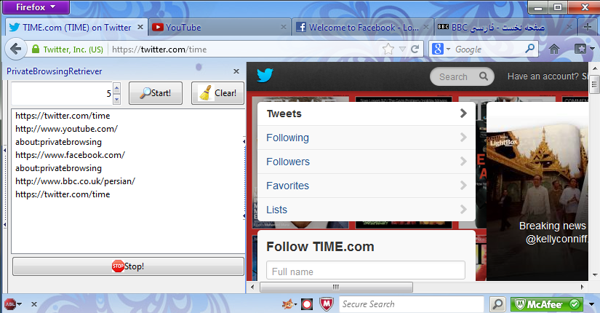
Firefox extension (proof of concept)
Records all user activities in private session
Then sends to a remote server

Slide 13
Addressing the threat of extensions
One straightforward solution is to disable extensions by default in the private mode
Adopted by Google Chrome and Microsoft IE
However, we still need to be careful.

Slide 14
Cross mode interference
Chrome allows two modes to run in parallel
Normal mode window: extension enabled
Private mode window: extension disabled
However, since the two windows share some common resources
Attacker may exploit cross mode interference

Slide 15
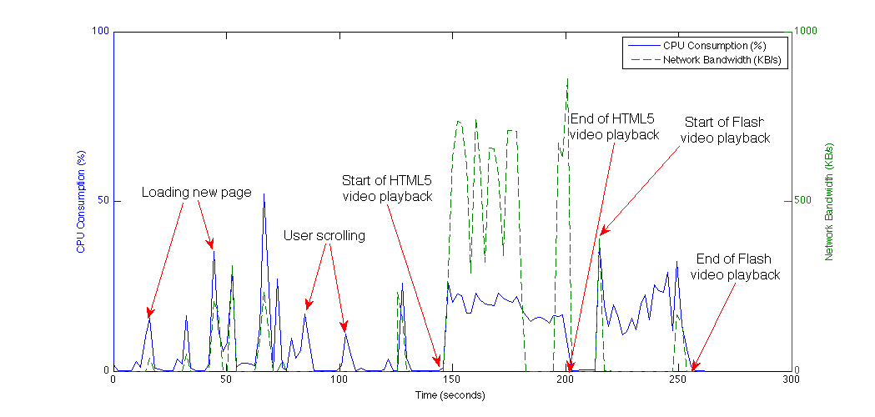
Example of cross mode interference
Our suggested countermeasure: always run in a single mode

Slide 16
Remote attacks
Goal of attack: remote website wishes to find out if the user is in the private mode.
E.g., if the user is in the private mode, remote website may push more adult-oriented content or advertisement.
Hence, we consider the fact of using private browsing a privacy feature itself.

Slide 17
Example: cookie timing attack
The time it takes to write cookies is different between the usual and private modes.
We conducted extensive experiments to collect data.

Slide 18
Results (box plots)
With the exception of IE, the timing difference between the two modes is significant.

Slide 19
Conclusion
Is private browsing private?
We took a forensic approach
Defined a threat model to define “security”
Evaluated against local/remote attacks
Validated all previously known attacks
Discovered several new attacks
For further details
See the paper and also open source code

