Slide 1
Verifiable Classroom Voting
Feng Hao
School of Computing Science
Newcastle University
Innovation Fund Dissemination and Welcome Event
14 Dec, 2012

Slide 2
Background
UTLSEC innovation project (Jun-Aug, 2012)
Aim: verifiable classroom voting based on using smart phones as voting clients
By comparison, TurningPoint classroom voting system is not verifiable.
TurningPoint also relies on using proprietary hardware for voting clients and server

Slide 3



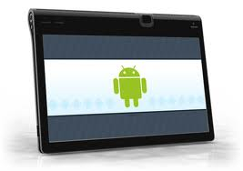
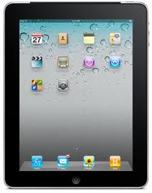
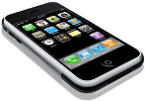

Overview of our system
Security
Integrity of the results protected by cryptography
Privacy
Voting is anonymous
Convenience
Voting can happen at anywhere
Maintenance-free
Students maintain their own devices, not us
Web server
Internet
Voting clients (iPhones, Android phones etc)

Slide 4
Underlying Technology
It’s the first verifiable classroom voting system
Based on a new “self-enforcing e-voting” technology (2012 ERC starting grant)
The entire voting system is authority-free.

Slide 5

Demo
Three ways to vote
Android phone/tablet: search for “Newcastle University eVoting” in Google play and install the app
iPhone/iPad: search for “Newcastle University eVoting” in the app store and install the app
All other smart phones, laptops, Visit http://evoting.ncl.ac.uk
To participate in voting, try
Session ID: 94
Passcode: 1234

Slide 6
Acknowledgements
Three months hard work by two students during summer, 2012
Mr Carlton Shepherd
Currently a CS Stage 3 student
Developed the Android app
Dr Dylan Clarke
Currently an RA
Developed the iPhone app and web server

Slide 7
What’s next?
Extending the system to other Schools for trials
We welcome any collaboration!
Integrating the system with Powerpoint
For example, a software Plug-in for Powerpoint
Improving usability of the system
It must be usable to people from all backgrounds (especially non-CS people)
Our ultimate goal
Making the system freely available to all universities, colleges, institutes, schools in the world

Slide 8

Thank you

